Slide 1
AI based motion control visualization of collision detection and path replanning
12.24 Jin Lexuan

Slide 2
This week's work
In last week's work, I completed measurement of two segment, and judging whether there is collision.
In this week, collision detection part is combined with path replanning part, path of low priority can be replanned and collision can be eliminated
Two show the results of path replanning, i also did visualization of distance

Slide 3
Review of previous PPT
Path replanning for 2 UAVs:
1.set priority for each UAVs
2.collision point detetion for 2 path
3.if no collision
calculate trajectory for each part
else
high priority UAV keeps original path
replan the path of the UAV with lower priority:
a. calculate the time when high priority UAV pass the collision point
b. slow down the velocity of low priority UAV, replan the path make sure it pass the collison point when high priority UAV passed
c. calculate trajectory for new path

Slide 4
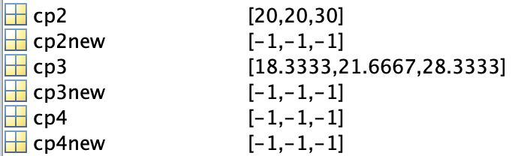
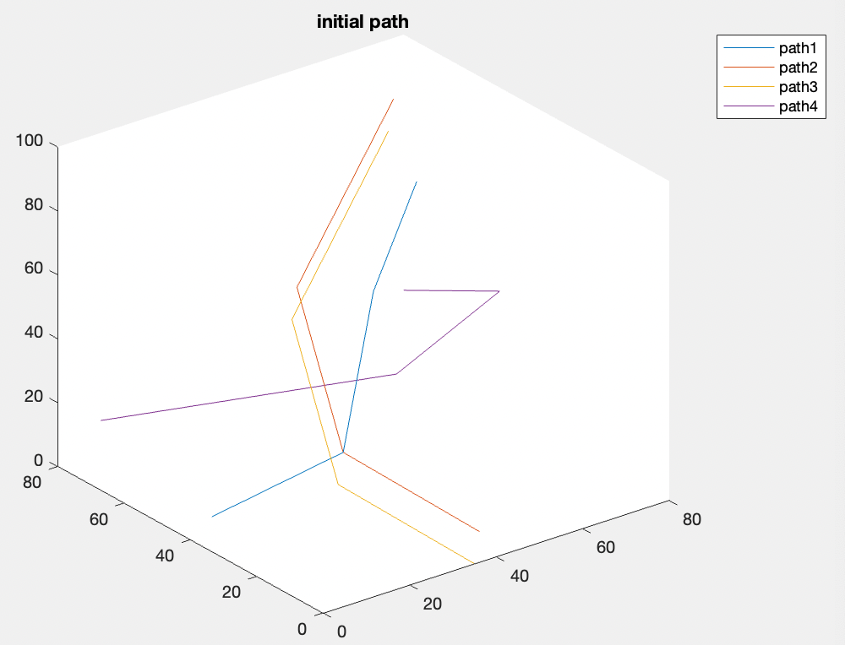
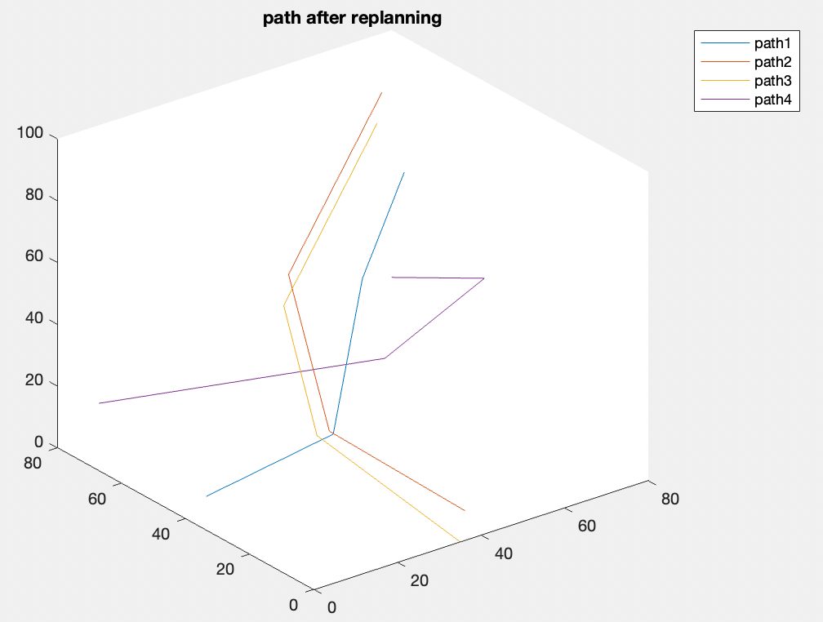
Results of path replanning

Slide 5
Distance visualization for two segment
for each point on the first segment,Distance visualization shows its minimum distance to another segment.
x=x0+t(x1-x0) y=y0+t(y1-y0) z=z0+t(z1-z0) (t from 0 to 1 step 0.01)
Visualization presents the change of distance directly, it shows whether there is a part of minimum distance is under the collision threshold
It also shows the performance of path replanning part clearly
Next two picture shows the distance of two segment before and after path replanning

Slide 6
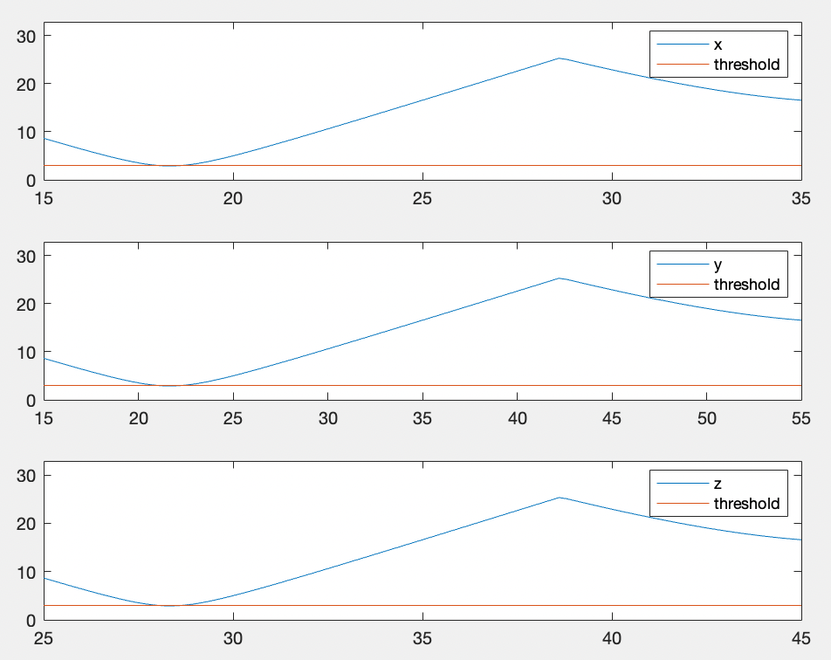
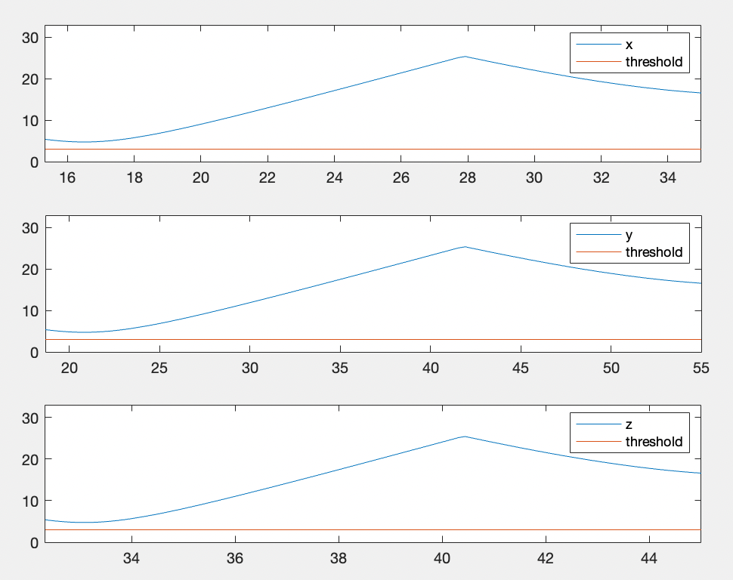
Visualizing distance for segment
Distance before replanning
Distance after replanning

Slide 7
Future question to think
this whole part is completed in the environment of no obstacles, only path of UAVs is considered. Problems may appear when there are obstacles, for example, to detect whether the replanned path is in range of obstacles, if so, path have to be regenerated again.
Path from RRT have more segment than I set now, this may also generate problems.

